Slide 1
Extending Linear Regression

Slide 2
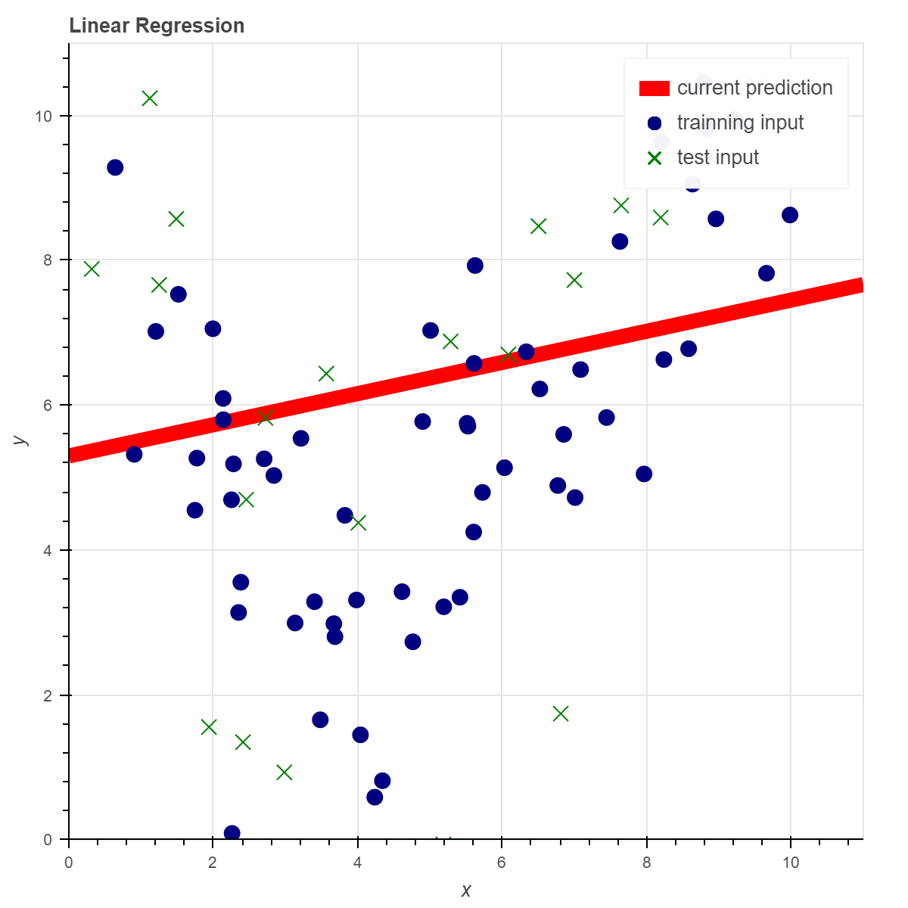
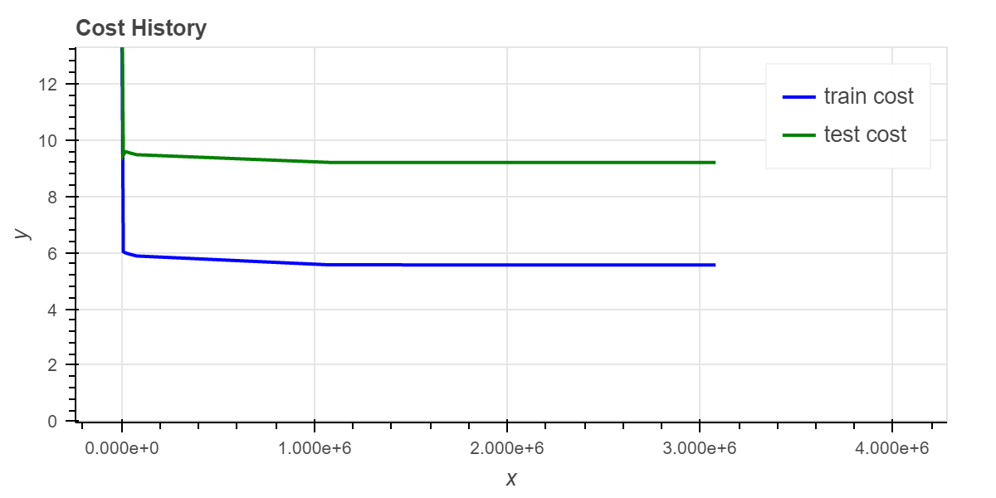
Underfitting
The function of a line is not always going to give the best fit to our data.
When our heuristic does not map to our data well we call this underfitting.
Underfitting will cause will cause both our training and our test data costs to be high, as samples from both sets will not be well represented in our result.

Slide 3
Underfitting
Underfitting occurs when the heuristic used has high bias and low variance.
Bias means the heuristic “assumes” too much. Assuming all data falls on a line is highly biased.
Variance is the opposite of bias. If our heuristic can map very closely to non-linear training data it likely has a high variance.
We will see that having high variance can be a bad thing as well.

Slide 4

Polynomial Features
To fit non-linear data with our heuristic we can introduce polynomial features.
Instead of using just one feature (x) in our heuristic we can use that feature raised to a number of exponents, each with their own input weight to be adjusted…
$h_{θ}\left(x\right)= θ_{0}+θ_{1}x+θ_{2}x^{2}+θ_{3}x^{3}$ $+θ_{4}x^{4}+…+θ_{n}x^{n}$
We could even go like this for consistency:
$h_{θ}\left(x\right)=θ_{0}x^{0}+θ_{1}x^{1}+θ_{2}x^{2}+θ_{3}x^{3}$ $+θ_{4}x^{4}+…+θ_{n}x^{n}$
$x^{0}$ = 1, $x^{1}=x$

Slide 5
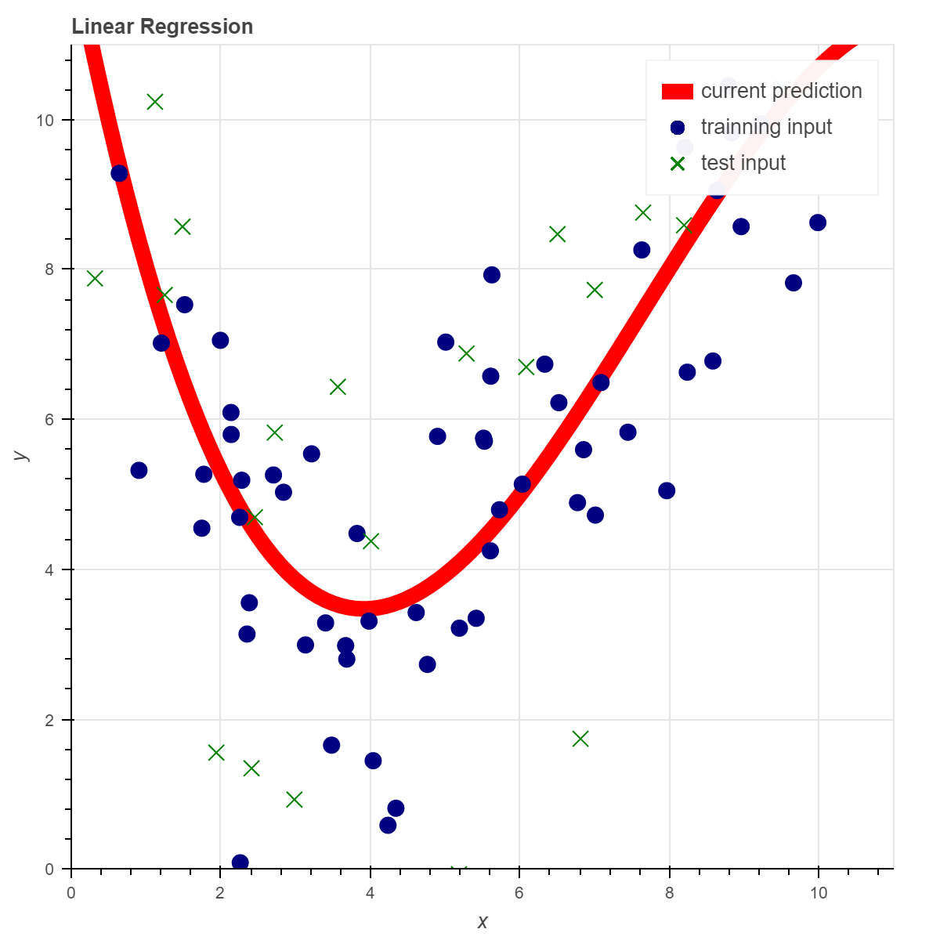
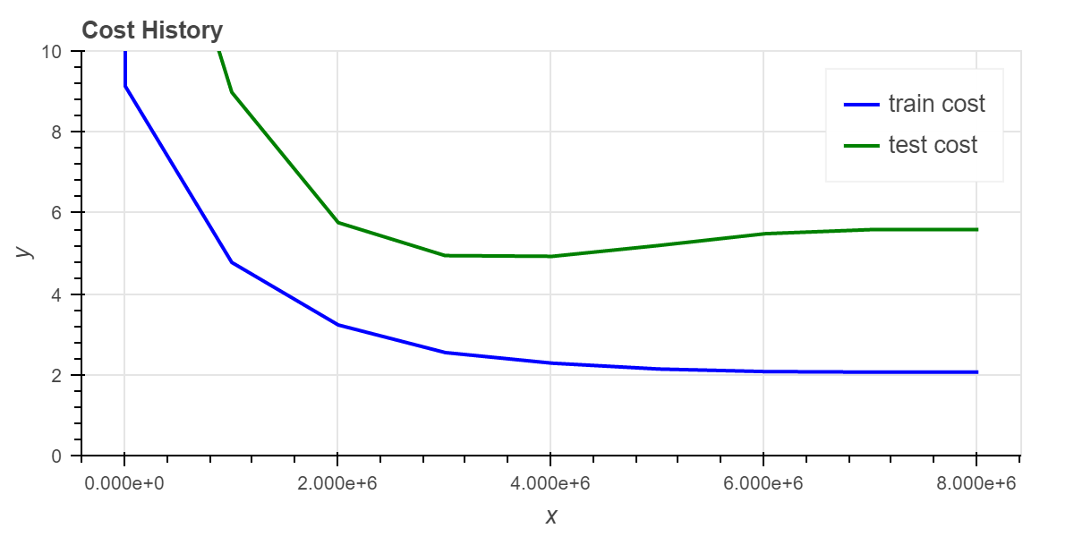

Polynomial Features
$h_{θ}\left(x\right)=θ_{0}x^{0}+θ_{1}x^{1}+θ_{2}x^{2}+θ_{3}x^{3}$ $+θ_{4}x^{4}+…+θ_{n}x^{n}$
We can arbitrarily decide what polynomial to raise our features to if we have knowledge of the data set, or we can test our results with a range of polynomial levels to see which gives us the best results.

Slide 6
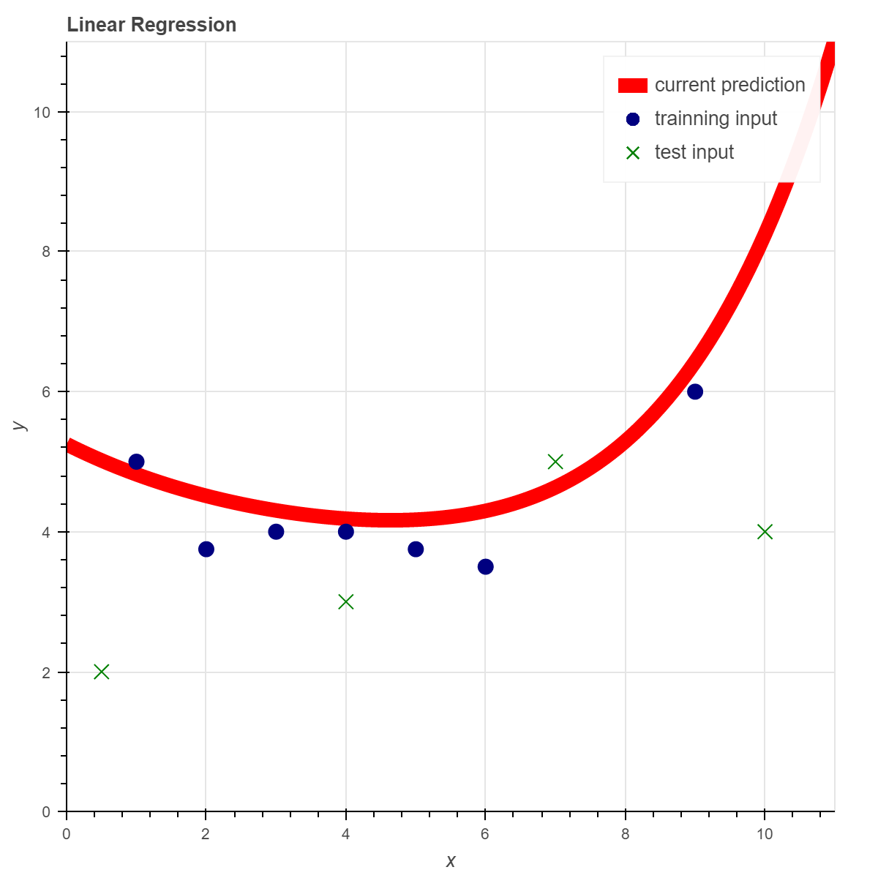
Overfitting
With polynomial features we can create a heuristic that will match our training features very closely, but fails to map well to our test data. This is called overfitting.
Overfitting happens when our heuristic has low bias and high variance.
Overfitting can be reduced by:
Increasing our input data size
Reducing the polynomial level of our heuristic
Adding regularization to our gradient descent

Slide 7

Regularization
The goal of regularization is to reduce our input weights, causing our resulting heuristic to favor results that are closer to a straight line.
Old cost function derivative:
$\frac{∂}{∂θ_{j}}J\left(θ_{j}\right)= \frac{1}{m}\sum_{i=1}^{m}{\left(h_{θ}\left(x_{i}\right) − y_{i}\right)} ∗x_{i}$
Cost function with regularization derivative:
$\frac{∂}{∂θ_{j}}J\left(θ_{j}\right)=\left(\frac{1}{m}\sum_{i=1}^{m}{\left(h_{θ}\left(x_{i}\right) − y_{i}\right)} ∗x_{i}\right)+ \frac{λ}{m}θ_{j}$
The addition of $\frac{λ}{m}θ_{j}$to our gradient descent will cause solutions with large weight values to have higher costs than those with low values.
$λ$ is our regularization rate. The higher we set it, the more bias our heuristic will have.

Slide 8
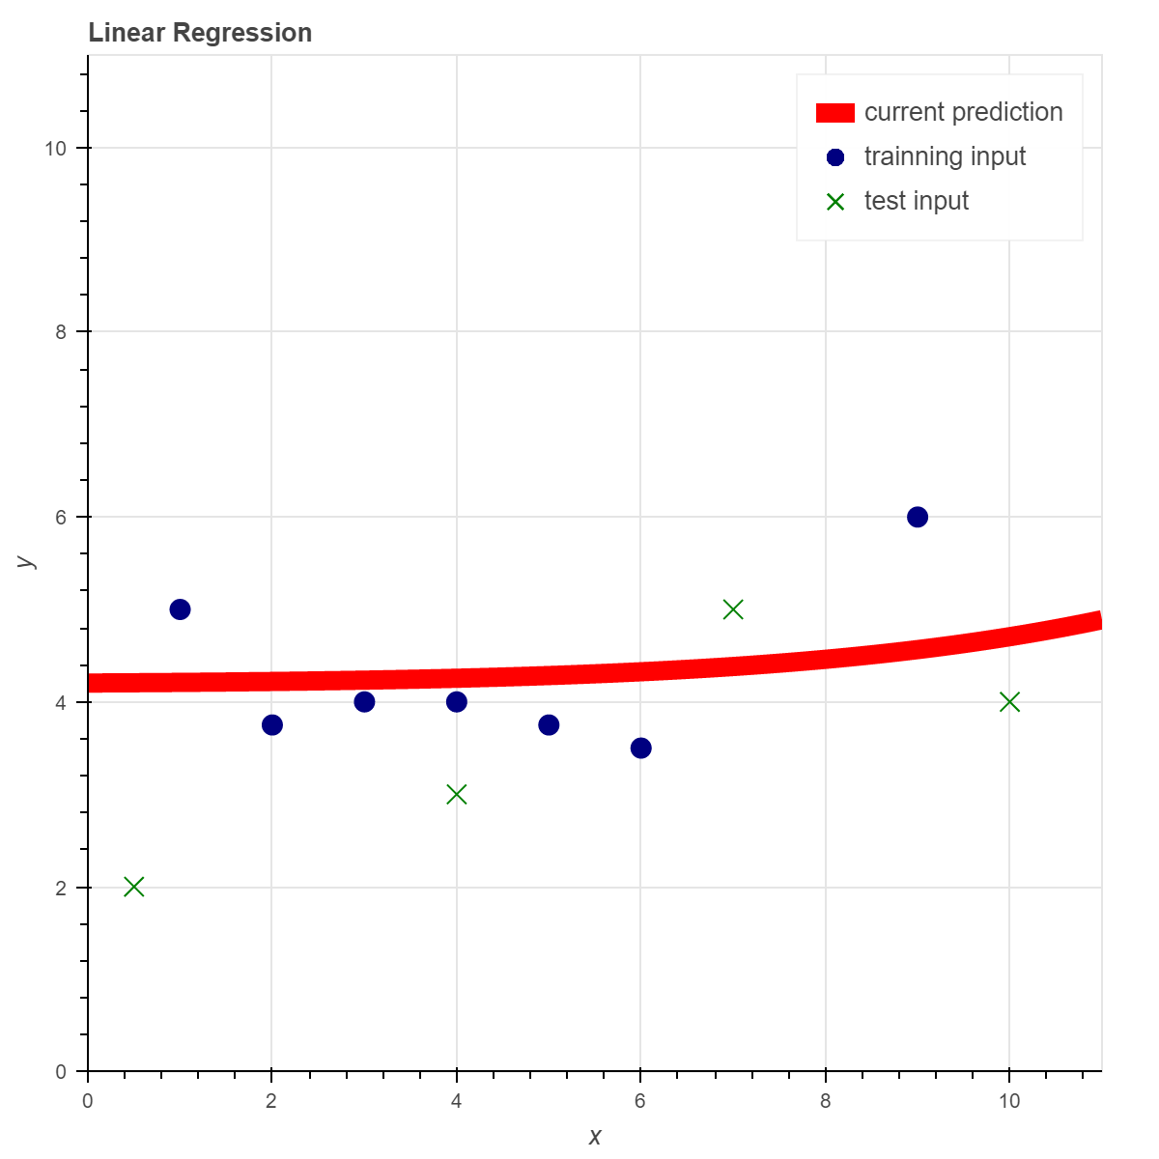
Regularization
With regularization we will not match our training data as well, but may match our test data better, indicating our heuristic will perform better on future data.
Without regularization we can match our training data very well, but may not match our test data.

Slide 9

Additional Features
Most interesting predictions will need to be made based on more than just one data point per feature, even a polynomial one.
We likely cannot get a very good universal prediction of house sales based only on square footage. We would likely need additional data points such as the number of rooms, fitness of location, number of floors, etc. to make up our features.
We can add additional data points to our heuristic in much the same way we added polynomial features:
$h_{θ}\left(x\right)=θ_{0}x_{0}+θ_{1}x_{1}+θ_{2}x_{2}+θ_{3}x_{3}+θ_{4}x_{4}+…+θ_{n}x_{n}$
Where $x_{0}$ through $x_{n}$ are different data points in the given feature$x.$

Slide 10

Normalization
When using multiple data points, and polynomial features, we are likely to have data points that have a high impact on our results based on their numeric range, instead of their actual impact on the results.
For the house sales example, sq. footage and number of rooms are likely both good features, but sq. footage is a value likely in the thousands, while the number of rooms is a much smaller number.
For polynomial features, for most values that $x$ could represent, $x^{n}$ is going to be much larger or smaller.
Dividing each feature by the range of that value will put all the features into roughly the same range.
Normalization will allow the use of a higher learning rate, and may reduce the possibility of converging in a local minima.

Slide 11

Vectorization
To get the best results possible, we will often have to use a large data set, with a high number of data points per feature and polynomial features.
The more data we use, the longer it will take for gradient descent to converge.
In order to better leverage the power of our computers, our formulas can all be “vectorized”:
$h_{θ}\left(x\right)=θ_{0}x_{0}+θ_{1}x_{1}+θ_{2}x_{2}+θ_{3}x_{3}+θ_{4}x_{4}+…+θ_{n}x_{n}$ becomes:
$h_{θ}\left(X\right)=$ X$Θ$
Where $Θ$ is a column vector of our input weights
and$X$ is row major matrix where each row represents the data points of one feature from our training data.

Slide 12


Vectorization
Cost function vectorization:
$J\left(θ\right)= \frac{1}{2m}\sum_{i=1}^{m}{{\left(h_{θ}\left(x^{i}\right) −y^{i}\right)}^{2}}$ becomes:
$J\left(θ\right)= \frac{1}{2m} {\left(\text{X}Θ −\begin{aligned}→ \\ y\end{aligned}\right)}^{T}\left(\text{X}Θ −\begin{aligned}→ \\ y\end{aligned}\right)$
Where $\begin{aligned}→ \\ y\end{aligned}$ represents a vector of all labels.

Slide 13

Vectorization
Gradient Descent vectorization:
repeat until convergence { for each $θ_{j}$ $θ_{j}$update = $θ_{j}−α$ $\frac{∂}{∂θ_{j}}J\left(θ_{0},θ_{1}\right)$ for each $θ_{j}$ $θ_{j}$= $θ_{j}$update }
Becomes: repeat until convergence { for each $θ_{j}$ $θ_{j}$update = $θ_{j}−\frac{α}{m}{\text{X}}^{T}\left(\text{X}Θ −\begin{aligned}→ \\ y\end{aligned}\right)$ for each $θ_{j}$ $θ_{j}$= $θ_{j}$update }
To implement these vector based functions, you will need a system capable of inverting and multiplying vectors and matrices of arbitrary sizes.
Don’t write this support yourself, unless you really want to. Get a preexisting library with GPGPU support for best results.
Implementing these vector based solutions will be worth extra credit.

